Slide 1


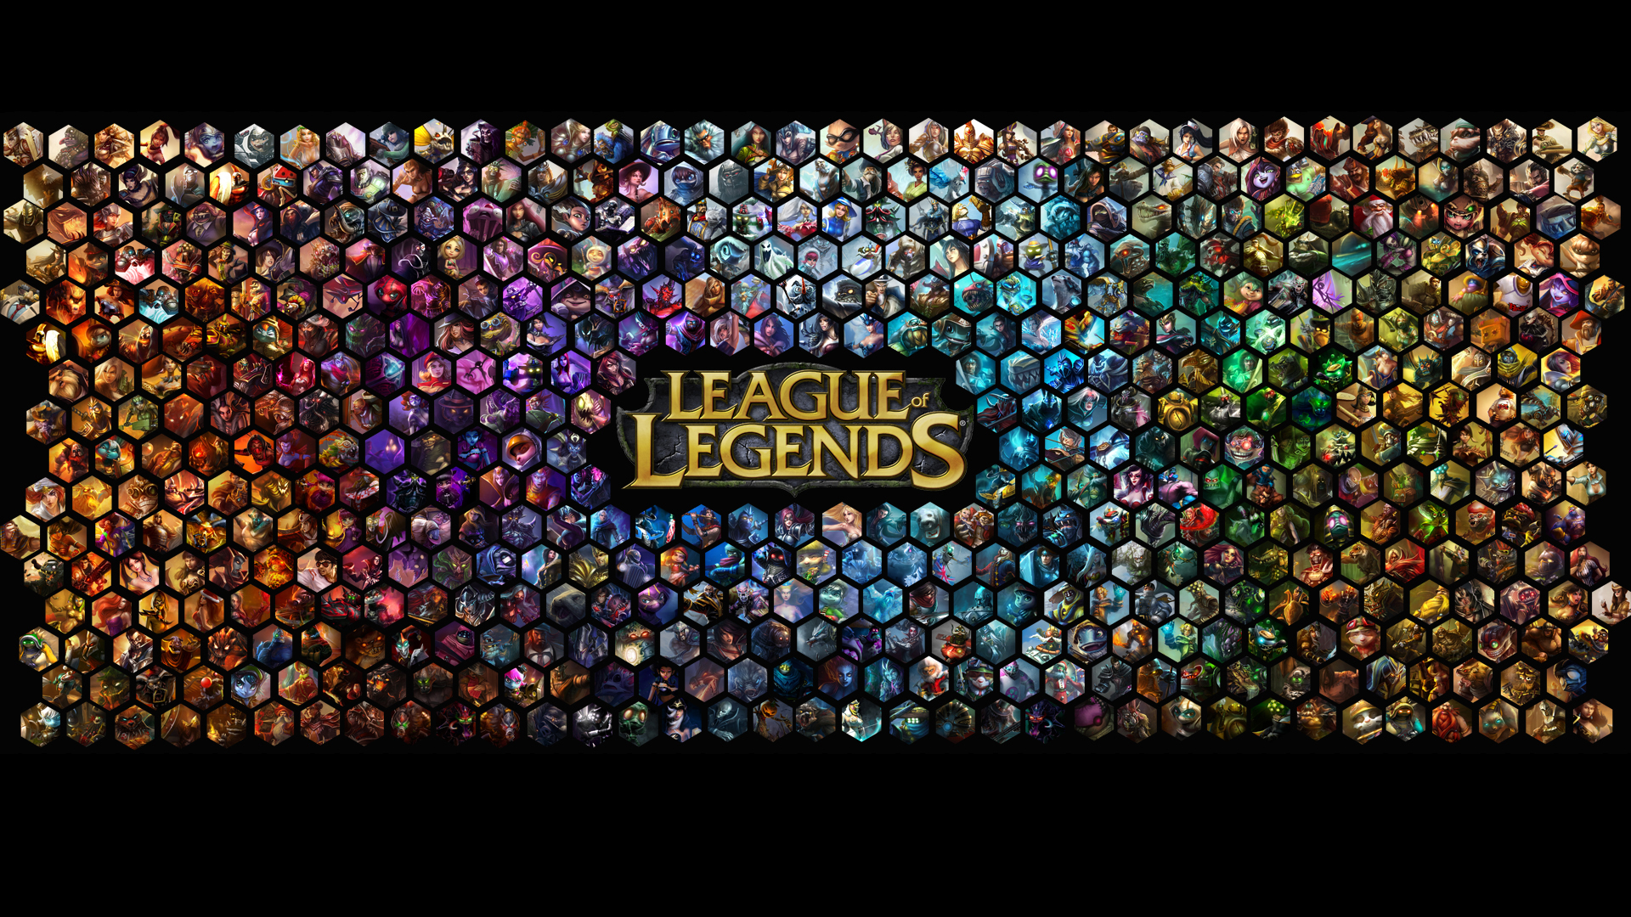


Slide 2
The Beginning
According to a post on the official Riot blog, Riot initially thought about releasing a boxed version of the game that users bought and waited for an expansion pack. However, it became clear that since it was an on-going game with no final boss or ending, this wouldn’t work.
Instead, Riot wanted an experience that improved every few weeks as opposed to one big update per year. They also needed a way to pay for the servers, hosting and constant development costs all year round instead of relying on people buying an expansion.

Slide 3
Finally, after lots of brainstorming Riot settled on a free to play model with optional purchases for players. This type of model did several things. First, it allowed people to play and become the best without having to spend anything

Slide 4
In 2008, Riot Games obtained initial funding of US $7 million provided by venture capital firms Benchmark Capital and First Mark Capital. In a second round of funding in 2009, the company raised $8 million from Benchmark That is 15 Million till the end of 2009 when the game came out.

Slide 5
Prime Time
Riot’s free to play business model has helped them generate billions of dollars over the course of the past several years. In fact, Riot hit the headlines in 2014 as they were just $36 million shy of hitting the $1 billion milestone in revenue. According to a report from PC Gamer, Riot made an impressive $964 million between January and September in 2014 putting them number 1 on the highest grossing game list.
Compared to their competitors like DOTA 2, League of Legends was clearly in front. In the same time frame DOTA 2 generated only $136 million which is a far cry from LoL’s $964 million. Around this time it was evident that their free to play model was working. If anyone ever had any doubts over them making money, they sure didn’t now.
Fast forward to the present, and League of Legends is still breaking records. In 2015 League of Legends pulled in $1.6 billion in revenue for Riot, confirming their place on the top of every highest grossing list. Around the same time, DOTA 2 brought in revenues of $238 million which was still nowhere near the number 1 MOBA.

Slide 6
The show is in honor of the tenth anniversary of Riot’s League of Legends, the company’s one and only title. League, or LoL as it’s known to rabid fans, has been successful far beyond anything Merrill and his cofounder, Brandon Beck, could have imagined when they launched the game in October 2009.
Every day, the game peaks at 8 million simultaneous players. Almost 100 million people streamed last year’s World Championship finals, which was won by Invictus Gaming
Over its lifetime, the game has generated $20 billion in revenue, making Merrill and Beck rich men, having sold the company in stages to Chinese internet giant Tencent, which valued the business at $366 million in 2011.

Slide 7
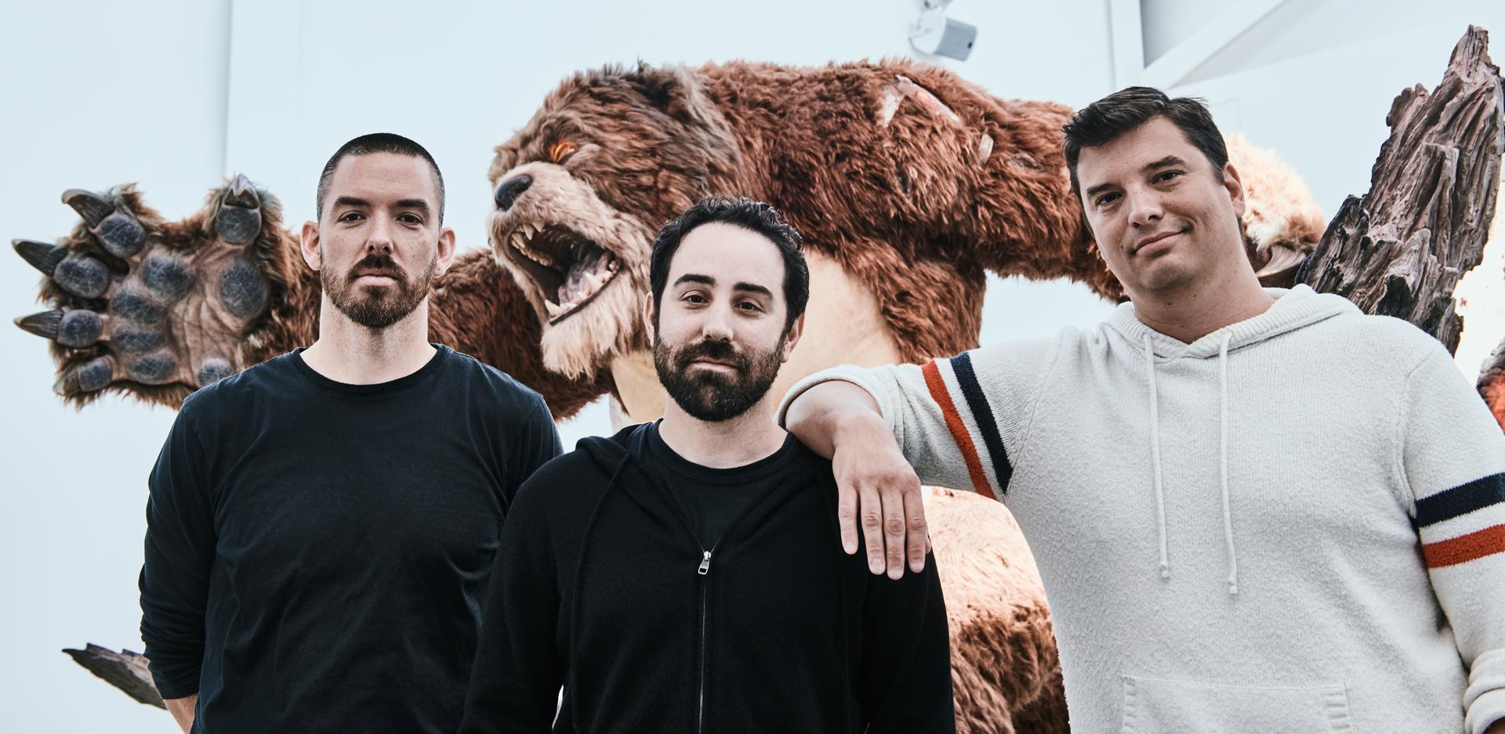

Slide 8
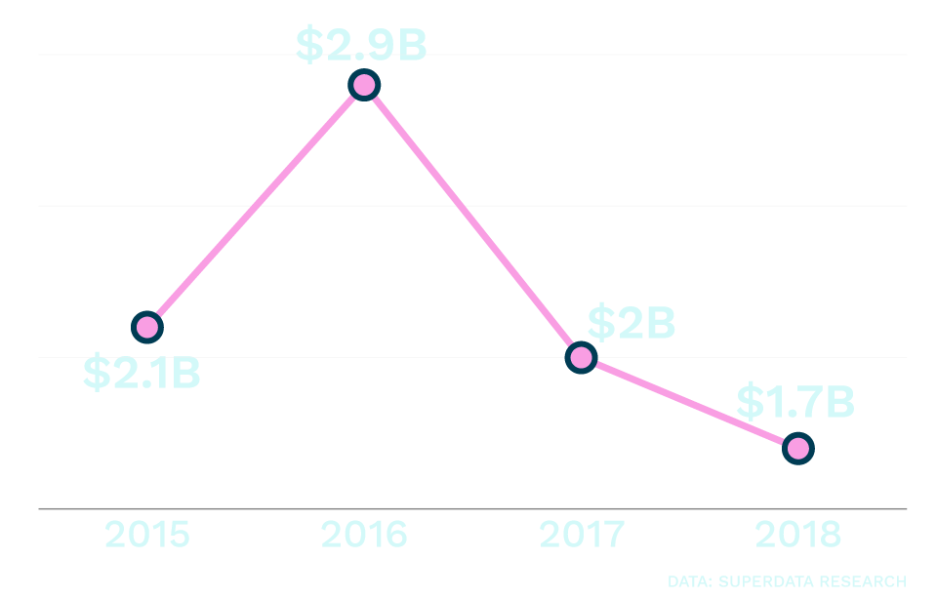
Ravenue

Slide 9
Future Plans
Riot’s game plan is nothing if not ambitious. First, it announced a mobile version of League called Wild Rift, as well as a version for its latest game mode called Teamfight Tactics. Both of those moves were expected. Less expected was a console version of the game. That’ll make League available to a much larger global audience, but since Riot is so late to the platforms, it might have trouble attracting new players.

Slide 10
A digital card game based on the LoL universe called Legends of Runeterra is also in the works, as well as a long-rumored fighting game that will feature select “champions” from League’s cast of 146.
Further off is another spinoff that will involve exploring League’s fantasy world. And then there’s League of Legends Esports Manager, which will let players assemble and oversee a pro gaming roster, starting with China’s esports league next year.

Slide 11
And in the biggest move of the evening, Riot announced an entirely new game: a yet unnamed tactical first-person shooter game with no connection to League. It doesn’t have a release date yet, and it’s far from certain to be a hit—or even released
Making a new game universe from scratch is a risky and costly proposition. But Riot seems to sense that it’s time to make some serious bets
It has committed to producing multiple seasons of an animated LoL television series that aims to offer backstories for two of its iconic champions

Slide 12
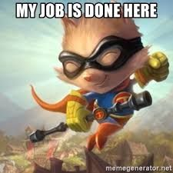
Thank you for attention!
Made by: Fran Pintaric

